Slide 1
MT104-Linear Algebra

Slide 2
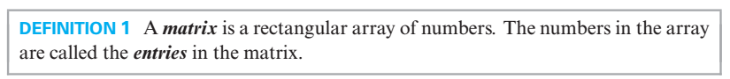

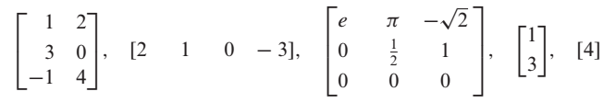
A

Slide 3
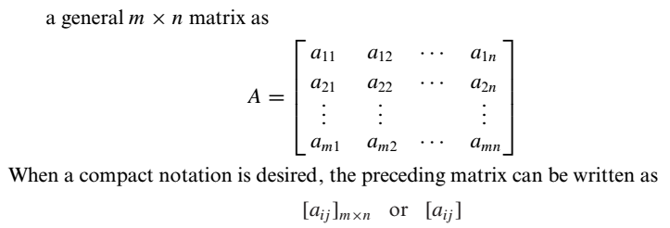
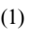
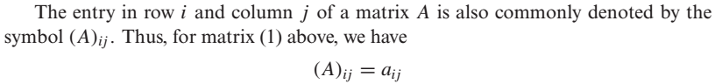
A
is

Slide 4
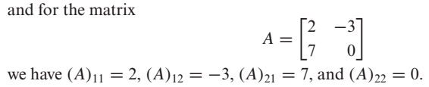

Slide 5
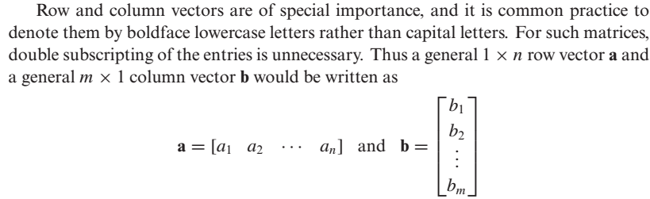
Row Vector and Column Vector

Slide 6
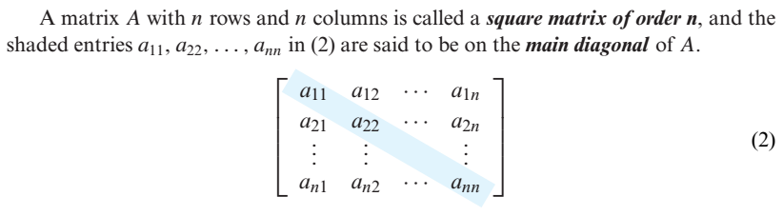
Square Matrix and Main Diagonal

Slide 7

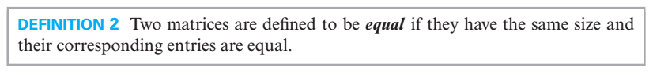
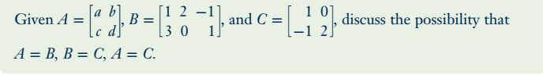
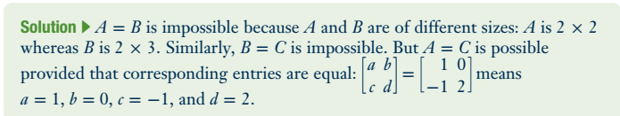
Problem

Slide 8
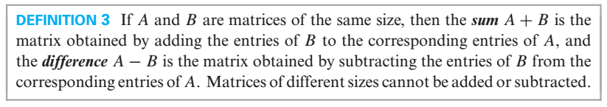
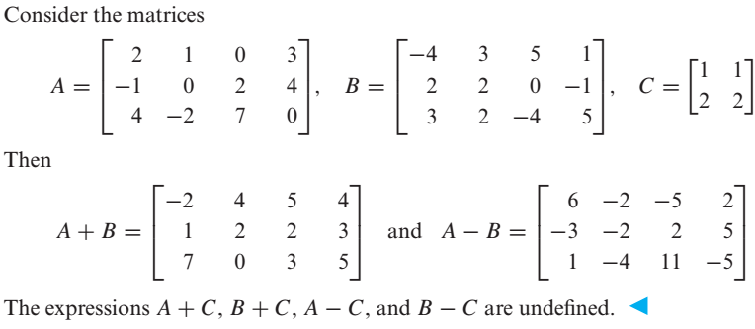

Slide 9
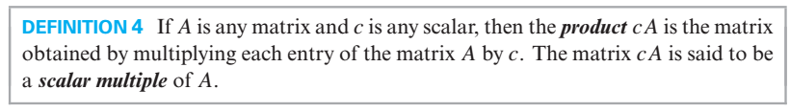
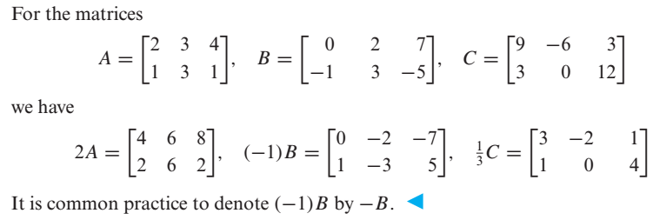
Scalar Multiples of a Matrix

Slide 10
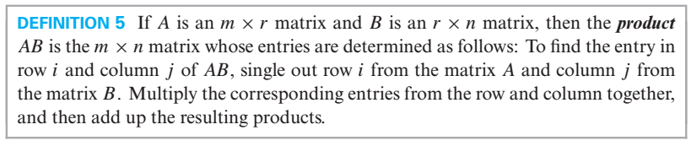
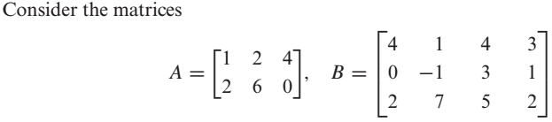
Product of Two Matrices

Slide 11
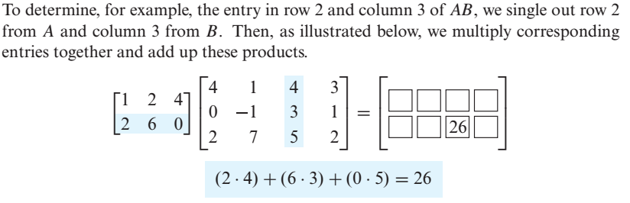
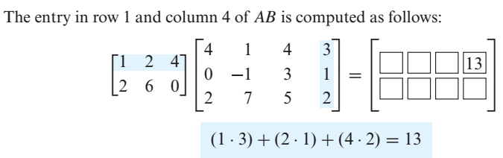

Slide 12
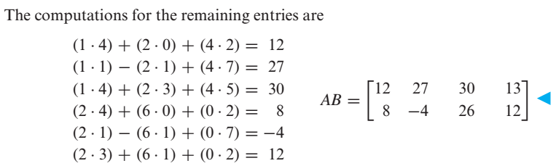

Slide 13
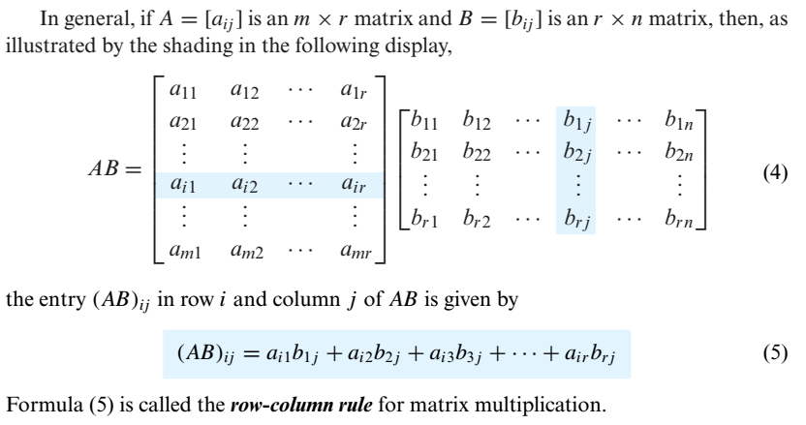

Slide 14

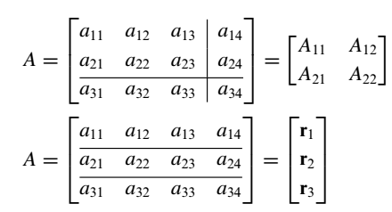
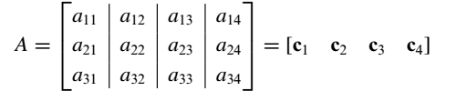
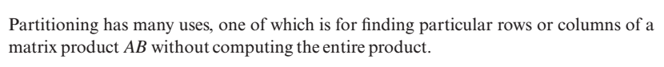
e.g

Slide 15

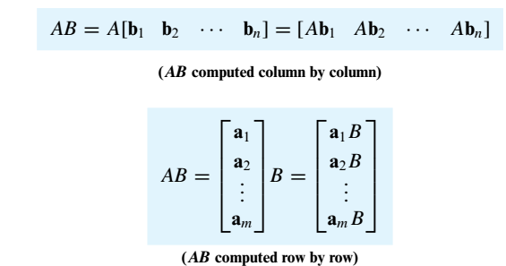

Slide 16
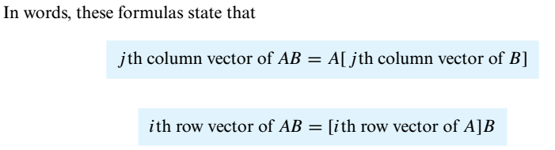
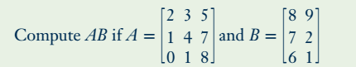
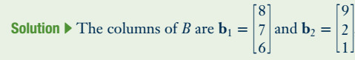
Problem

Slide 17
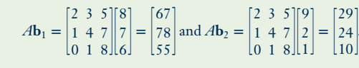
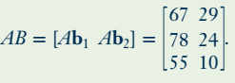

Slide 18
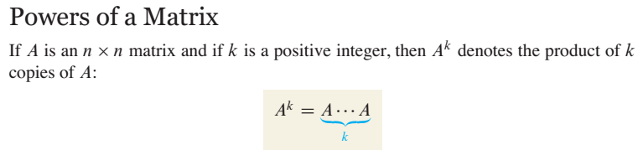
For instance , in order to find $A^{2}$ we will multiply $A$ with $A$.

Slide 19
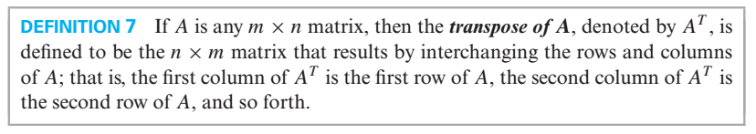
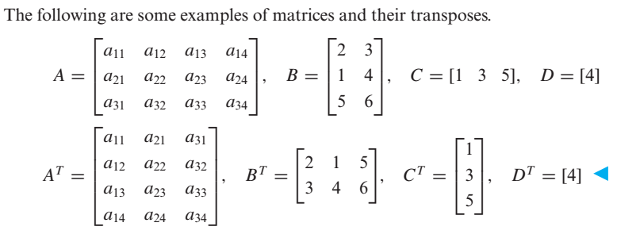
Transpose of a Matrix

Slide 20
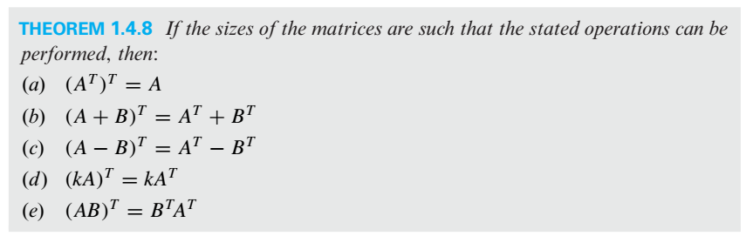
Properties of Transpose

Slide 21
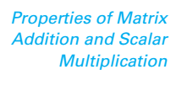
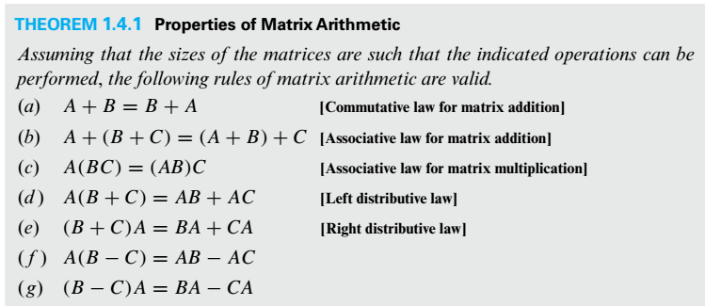

Slide 22
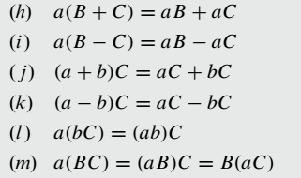

Slide 23
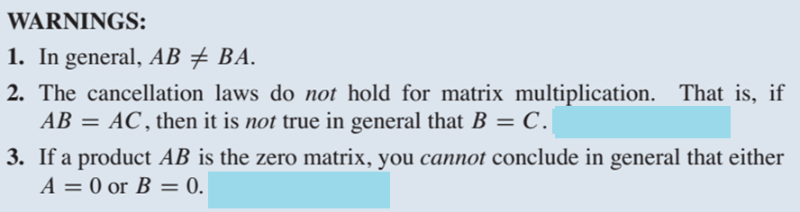
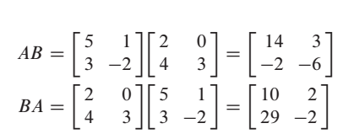
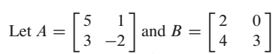
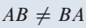
Example on Point 1

Slide 24
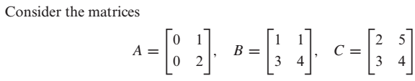
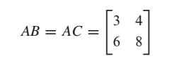
Example on Point 2
Here
But

Slide 25
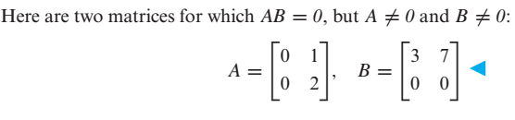
Example on Point 3

Slide 26

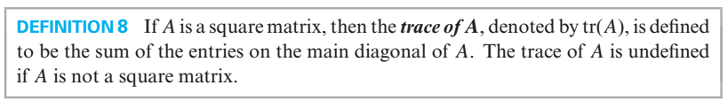
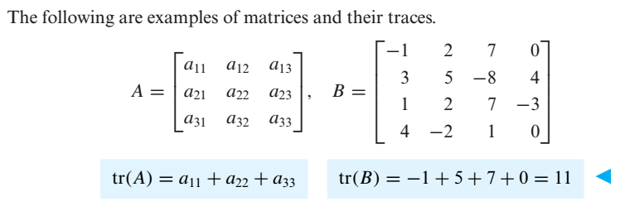

Slide 27
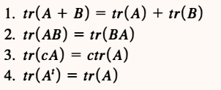

Slide 28

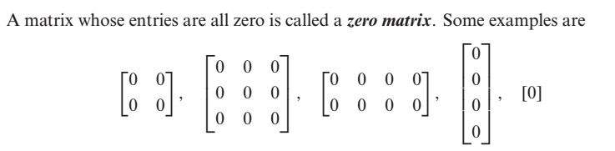

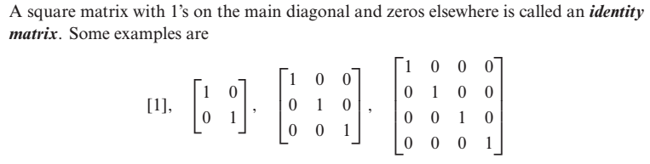

Slide 29

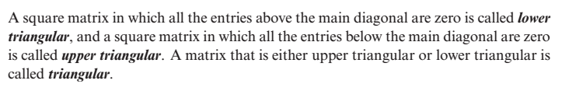


Slide 30




Slide 31


Slide 32





Equivalent Matrices
e.g $I_{2}$and the matrix
are equivalent because we can obtain A from identity matrix by multiplying row 2 by -3
Elementary Matrix

Slide 33


Slide 34


Determinants
For 2×2 Matrices the formula is
Let’s talk about minor and cofactor of an element with the help of which we will calculate determinants of higher order matrices.

Slide 35




Minor & Cofactor of an element (In a Square Matrix)

Slide 36


Slide 37



Slide 38



Problem
By cofactor expansion along the first Row

Slide 39


By cofactor expansion along the first coulmn

Slide 40



Slide 41

e. g

Slide 42



Slide 43



Slide 44



Slide 45




Slide 46




Slide 47



Slide 48



Slide 49




Slide 50



Slide 51



In general

Slide 52

Evaluating Determinants by Row Reduction

Slide 53




Slide 54




Slide 55



Slide 56



Slide 57





Slide 58



Slide 59


Slide 60





Inverse of a 2 $×$ 2 Matrix

Slide 61


Slide 62





Problem
Find the inverse of the matrix
Sol
Another method for finding inverse of a matrix is illustrated in the coming slides.

Slide 63



Slide 64


Slide 65



Slide 66


Slide 67


Note

Slide 68



Slide 69





Slide 70


Slide 71





Slide 72

General Form of a Diagonal Matrix

Slide 73


Inverse of a Diagonal Matrix
Power of a Diagonal Matrix

Slide 74


Slide 75


A matrix is said to be in Echelon form if it has the following properties
Every nonzero row precedes every zero row.
In each successive nonzero row, the number of zeros before the leading entry of a row
increases row by row.

Slide 76





Slide 77


Rank of a Matrix
The number of nonzero rows in the echelon form of a matrix is called rank of the matrix.

Slide 78






Linear System
is a solution of

Slide 79


In matrix form, we can write ( ) as
where,
A is called the

Slide 80


Slide 81




Slide 82


Slide 83

Important Points about Linear Systems
There are a lot of methods for solving linear systems, some methods work in special cases while some works for every type of linear system.
If in a linear system the number of equations is equal to the number of unknowns ( i.e. if the coefficient matrix is a square matrix i.e. if m = n ) then from determinant we can comment about the number of solution(s).
Any linear system in which $m=n$, and $\left|A\right|≠0$, has a unique solution. We can obtain this
unique solution by any of the following methods:
(i) Matrix Inversion Method (ii) Cramer's Rule
(iii) Gauss Elimination (iv) Gauss-Jordan Elimination
Furthermore, if the system is homogeneous then this unique solution is the trivial solution
(zero solution).

Slide 84

A homogeneous system has always a zero solution called trivial solution. Thus a homogeneous system is always consistent.
A homogeneous linear system in which $m=n$, and $\left|A\right|=0$, has infinite solutions ( i.e.
nontrivial solutions also exist).
5. In case of nonhomogeneous linear system in which $m=n$ and $\left|A\right|=0$, there is possibility
that the system has
(i) No Solution (ii) Infinite Solutions
6. If in a linear system the number of equations is not equal to the number of unknowns ( i.e. if
the coefficient matrix is not a square matrix i.e. if m $≠$n ) then we can comment about the
number of solution(s) by looking into the rank of coefficient matrix, rank of augmented
matrix and number of unknowns in the system. In this case we can find the solution(s) (if
exist) by either Gauss Elimination or by Gauss-Jordan Elimination.

Slide 85


Slide 86

(Because for homogeneous linear system Rank of the coefficient matrix is always equal to Rank of the augmented Matrix and if number of equations is less than unknowns this mean that common rank < n, so by third part of fundamental theorem, system will have infinite solutions.

Slide 87


Methods for solving a linear System
(or Gauss Elimination)

Slide 88


Problem

Slide 89





Slide 90





Slide 91





Slide 92



Slide 93




Slide 94




Slide 95



Slide 96


Slide 97


Slide 98


Problem

Slide 99


If we reduced the augmented matrix to reduce echelon form we have

Slide 100


Slide 101


Slide 102


Problem

Slide 103



e.g.

Slide 104





Slide 106



Slide 107




Slide 108


Slide 109


Slide 110


Slide 111



Slide 112


Slide 113



Slide 114






Slide 115




Slide 116



Slide 117


Slide 118




Slide 119


Linear Combination

Slide 120



Slide 121


Slide 122

Spanning Set

Slide 123



Slide 124


Two Major Problems to Address
Problem

Slide 125




Slide 126


Problem

Slide 127


Slide 128




Slide 129


Slide 130


Problem

Slide 131



Slide 132



Slide 133



Slide 134

Wronskian

Slide 135



Slide 136




Slide 137



Slide 138


Dimension

Slide 139



Slide 140


Slide 141



Slide 142



Slide 143



Slide 144


Problem

Slide 145


Slide 146


Problem

Slide 147



Slide 148





Slide 149


Problem
Solution

Slide 150


Slide 151


Slide 152



Problem

Slide 153



Slide 154



Problem

Slide 155




Slide 156




Slide 157



Slide 158


Problem

Slide 160



Slide 161



Slide 162



Slide 163





Slide 164


Slide 165



Slide 166


Slide 167


Slide 168



Slide 169


Practice Problems

Slide 170

Norm of a vector and Distance b/w two vectors in an Inner Product Space

Slide 171



Slide 172


Slide 173




Slide 174




Slide 175

Technique for making an orthogonal set an orthonormal Set

Slide 176



Slide 177

Problem

Slide 178


Simply speaking, orthogonality implies linear independency

Slide 179


Slide 180




Problem

Slide 181






Slide 182


Slide 183


Practice Problem

Slide 184




Slide 185



Slide 186


Slide 187


Slide 188



Slide 189



Slide 190


Slide 191


Slide 192


Slide 193


Slide 194



Slide 195


Problem
Also find least squares error vector and least square error.
Sol:

Slide 196




Slide 197


Slide 198


Problem

Slide 199



Slide 200


Slide 201

Note

Slide 202

Practice Problem

Slide 203



Slide 204


Slide 205


Slide 206



Slide 207


Slide 208


Slide 209

Problem

Slide 210


Slide 211




Slide 212

Problem

Slide 213




Slide 214




Slide 215




Slide 216


Slide 217


Slide 218


Slide 219



Slide 220


Slide 221

In short

Slide 222

Problem

Slide 223



Slide 224




Slide 225



Slide 226


Slide 227

Practice Problem

Slide 228


Slide 229


Slide 230


Slide 231


Slide 232


Slide 233


Slide 234


Slide 235


Slide 236

Problem

Slide 237


Slide 238


Slide 239

The question is : How to find the eigenvalues and eigenvectors of a given matrix.

Slide 240


Slide 242


Slide 243


Problem

Slide 244



Slide 245


Slide 246


Problem

Slide 247




Slide 248



Slide 249




Slide 250




Slide 251


Problem

Slide 252


Slide 253



Slide 254


Similarly

Slide 255


Slide 256



Similar Matrices

Slide 257





and
are similar matrices
because there is
such that

Slide 258

Diagonalizable Matrix
e.g
is diagonalizable
A is similar to the diagonal matrix
( Detail in previous Slide)

Slide 259


Slide 260


Slide 261


Problem

Slide 262




Slide 263



Slide 264



Slide 265



Slide 266




Slide 267



Slide 268


Problem

Slide 269




Slide 271


Slide 272




Slide 273


Slide 274





Slide 275



Slide 276




Problem
( Previous Slides )

Slide 277



Slide 278



Slide 279


Slide 280



Slide 281


Slide 282



Problem

Slide 283



Slide 284


Slide 285




Slide 286


Slide 287

Problem

Slide 288



Slide 289


Slide 290


Slide 291

Problem

Slide 292


Slide 293



Slide 294

Problem

Slide 295


Slide 296

Problem

Slide 297


Slide 298


Slide 299



Slide 300


Slide 301



Slide 302




Problem

Slide 303



Slide 304


Slide 305


Problem

Slide 306


Slide 307


Problem

Slide 308



Slide 309
Practice Problem

Slide 310




Slide 311


Slide 312


Slide 313


Slide 314


Slide 315


Slide 316



Slide 317



Slide 318

Now since every linear transformation from $R^{n}$ to $R^{m}$ is a matrix transformation and for a matrix transformation there should be a matrix which when multiplied with any domain vector give image. We will call such matrix the standard matrix for the linear transformation.

Slide 319


Method for finding standard Matrix for a Linear Transformation from $R^{n}$ to $R^{m}$

Slide 320



Problem

Slide 321




Slide 322

Practice Problem

Slide 323



Slide 324




Problem

Slide 325



(Because determinant of the standard matrix for T is non zero)

Slide 326


Slide 327


Slide 328


Slide 330


Slide 331



Slide 332


Practice Problem 1

Slide 333


Practice Problem 2
Answers

Slide 334





Slide 335



Slide 337
The End

